Slide 1
What are these slides about
Here I will uploads the screenshots of the commands with details of that command under it.
If the screenshots are not that clear then sir please check my other file that I gave you with this PDF
Lab report lecture 2 starts from 7no slide.

Slide 2
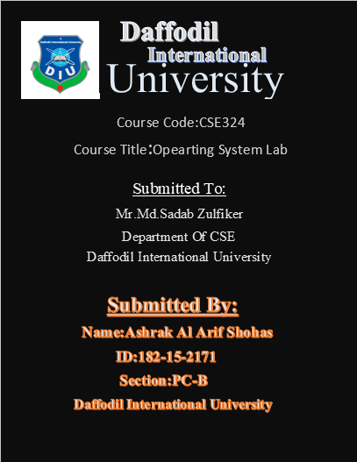

Slide 3
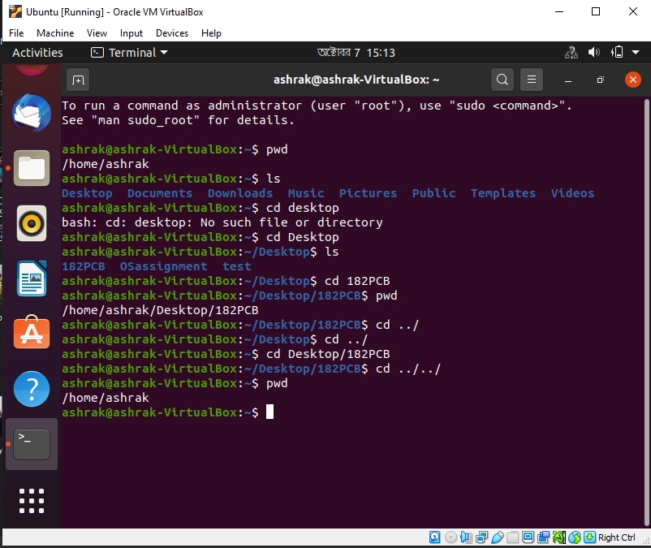
Here pwd means present working directory.
Ls command shows how many directory and files present in an individual directory
Cd is for changing the directory.
For going back to previous directory we use cd ../ and cd Directory name/ Directory name

Slide 4
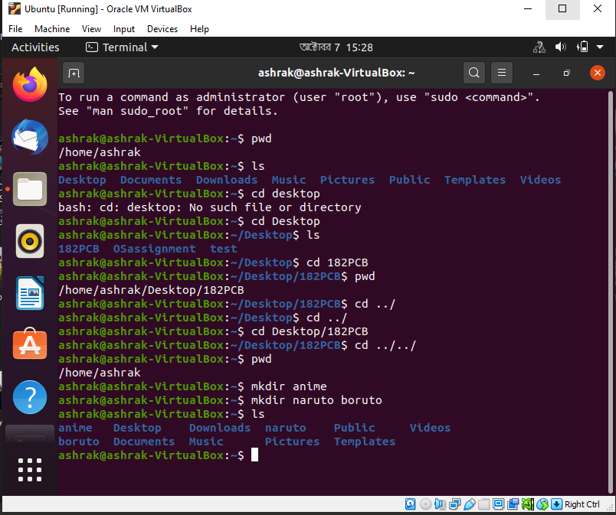
For to make a new directory we use the command ‘Mkdir’

Slide 5
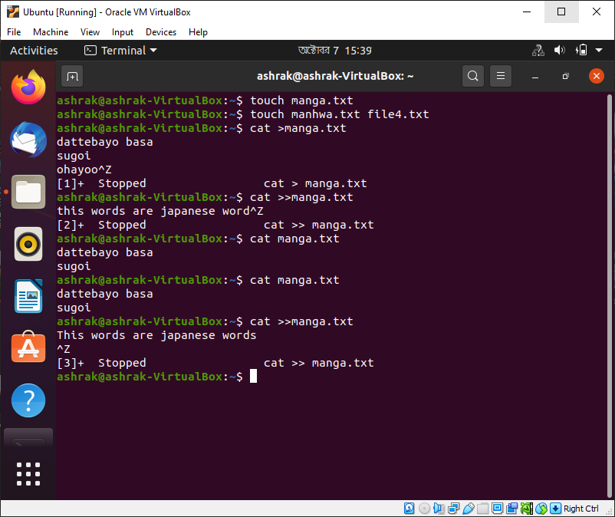
For to make a new text file we use the command ‘touch’ for to write something on that file text we use the command ‘Cat > file name’
To stop the writing we pressed cltr+z
For to add some new lines we use ‘cat >> filename’

Slide 6
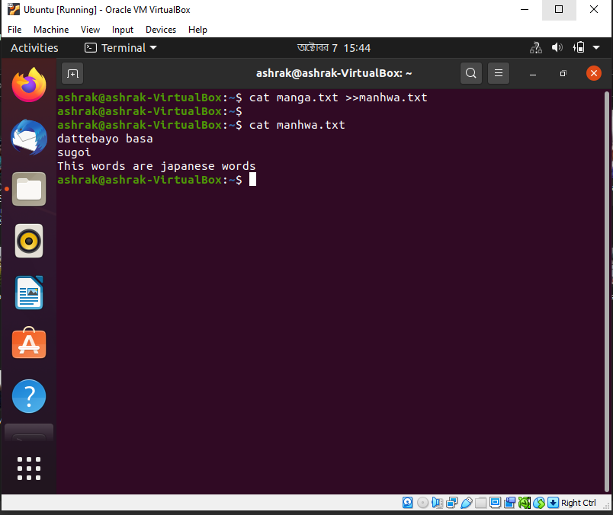
For to transfer the writing of one file to another file then we use the command ‘cat file name>>file name’

Slide 7
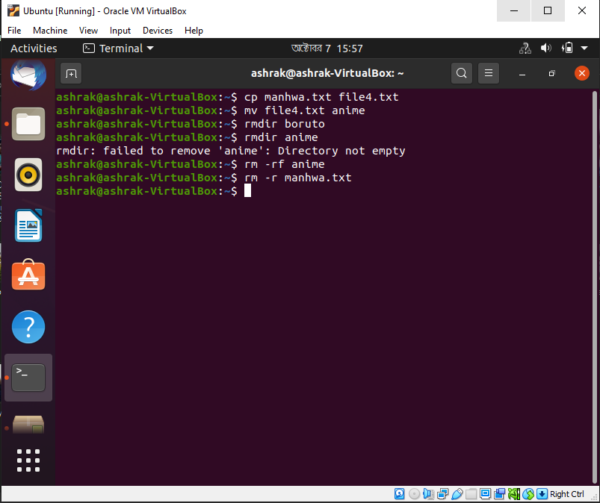
Here we copied one text file to another text file with the command ‘cp’
We move file to another directory by ‘mv’ command
We deleted a directory with the command ‘rm-rf’
We deleted a text file by typing ‘rm-r’
The results of these action are shown on the next slide

Slide 8
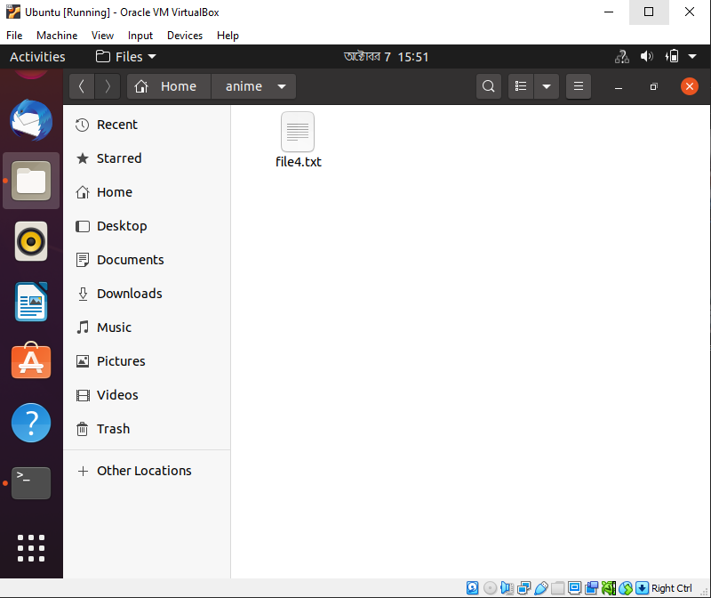
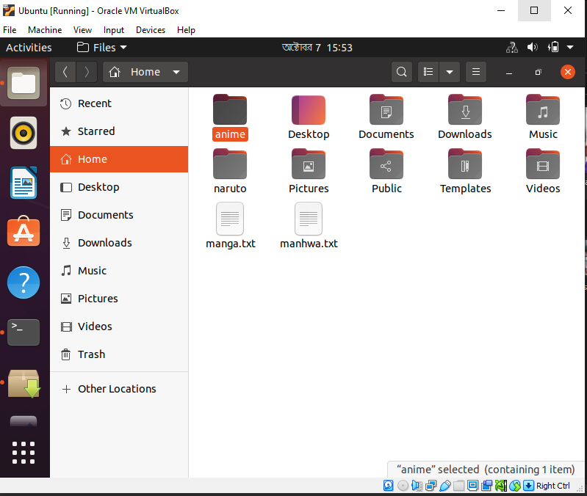
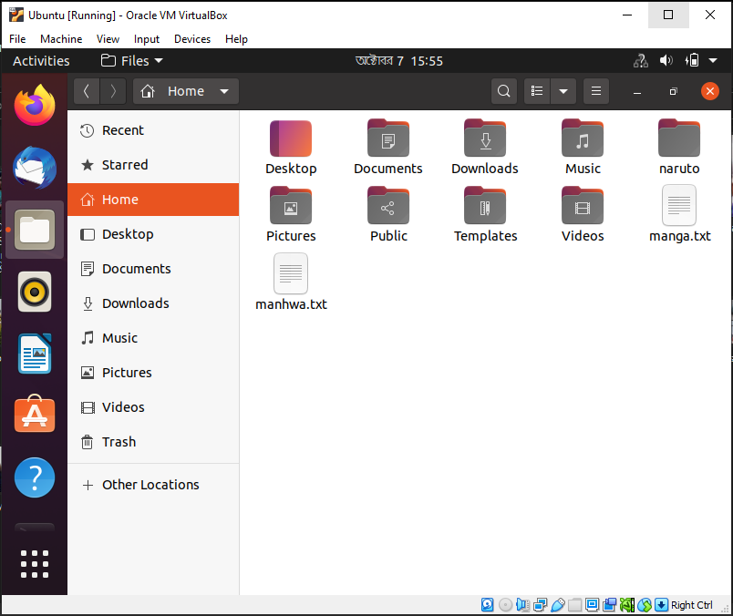

Slide 9
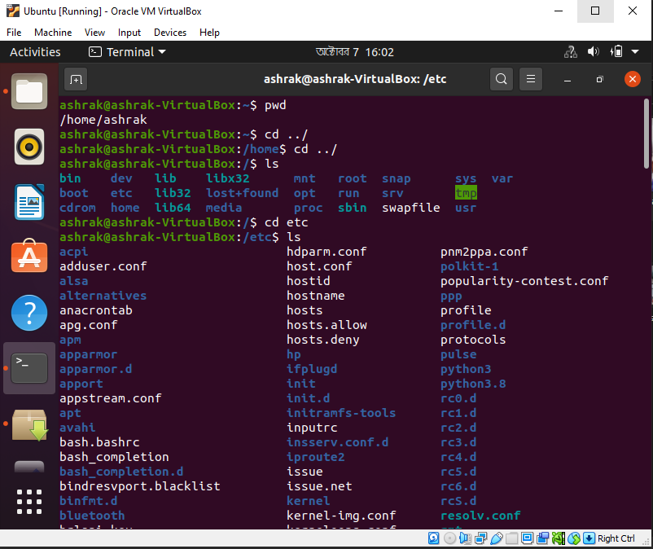
Here we go back to our main home and check the directories in this home then we select the directory named ‘etc’ where we will make a new directory.

Slide 10
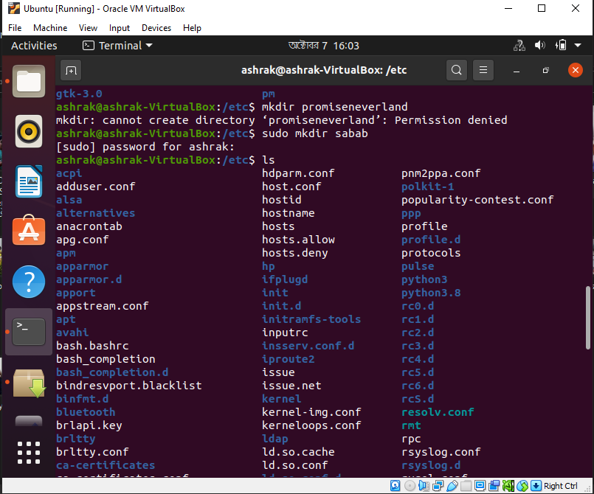
Here we found that we can not make directory by only writing the command ‘mkdir’.
Here we have to use ‘sudo mkdir’ command to make a new directory by giving accesable password

Slide 11
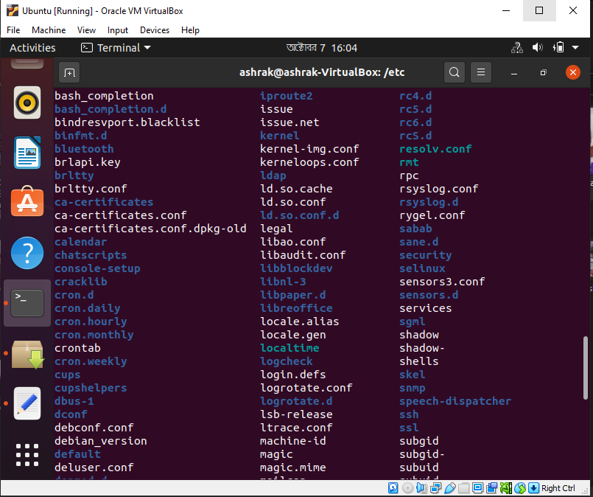

Slide 12
